Slide 1

Institute of Technology of Cambodia
Department of Applied Mathematics and Statistics
AMS-B
Project about Java
Project: The Best Route in Cambodia
Lecture: Chan Sophal

Slide 2
Group 4
Name ID
VEN VANNUTH e20201651
VANN VISAL e20200537
SENG VATHANAK e20200463
SANG RITHPORK e20200232
SET MONGKOL e20201255

Slide 3
Contents:
01
02
03
04
General introduction
Process
Reference
IDE

Slide 4
01
General introduction

Slide 5
As you know, nowadays our country has many route to travel. But the problem is that from one route to another there are different distances and the routes from a province to another has many route, which is a problem for travelers in choosing the route to travel. So we have created a system to find a route that is short and saves time to travels.

Slide 6
02
Process

Slide 7
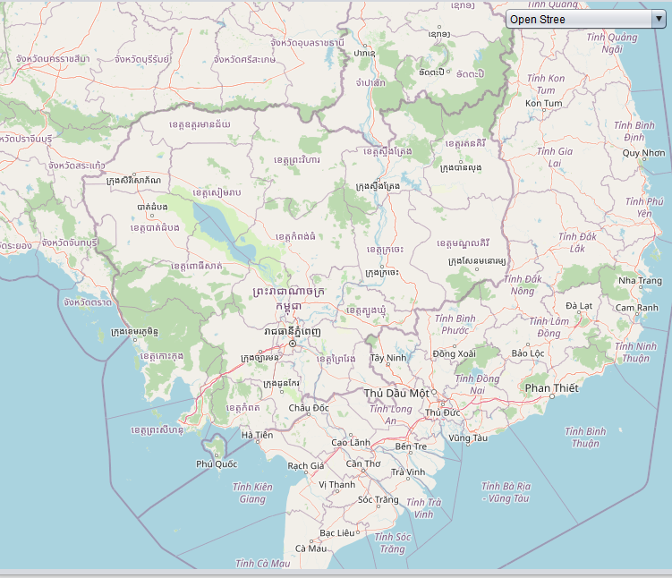
Our Project we devided to 4 parts:
+Part 1 : Our are project is got API Map from OpenStreetMap.

Slide 8
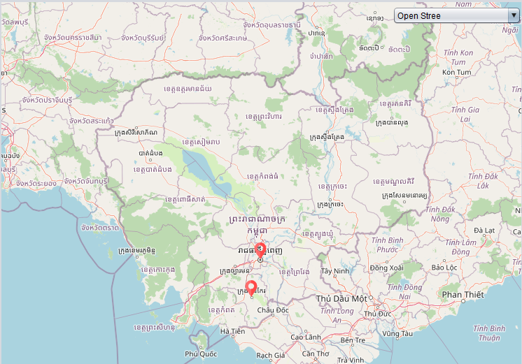
+Part 2 :We can set 2 point direction on Map

Slide 9
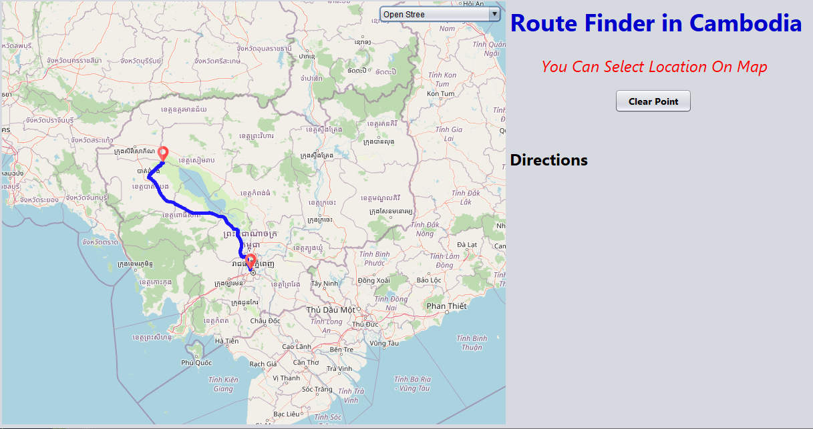
+Part 3 :We can set direction from 2 point.

Slide 10

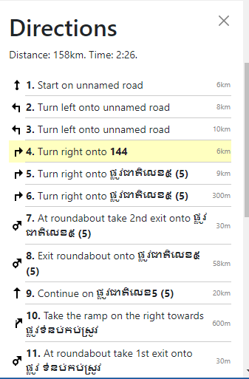
+Part 4 :We are going to set data for show information.

Slide 11
Reference
03

Slide 12


OpenStreetMap
GitHub

Slide 13
IDE
04

Slide 14

NetBeans IDE

Slide 15

Thanks!

